Slide 1

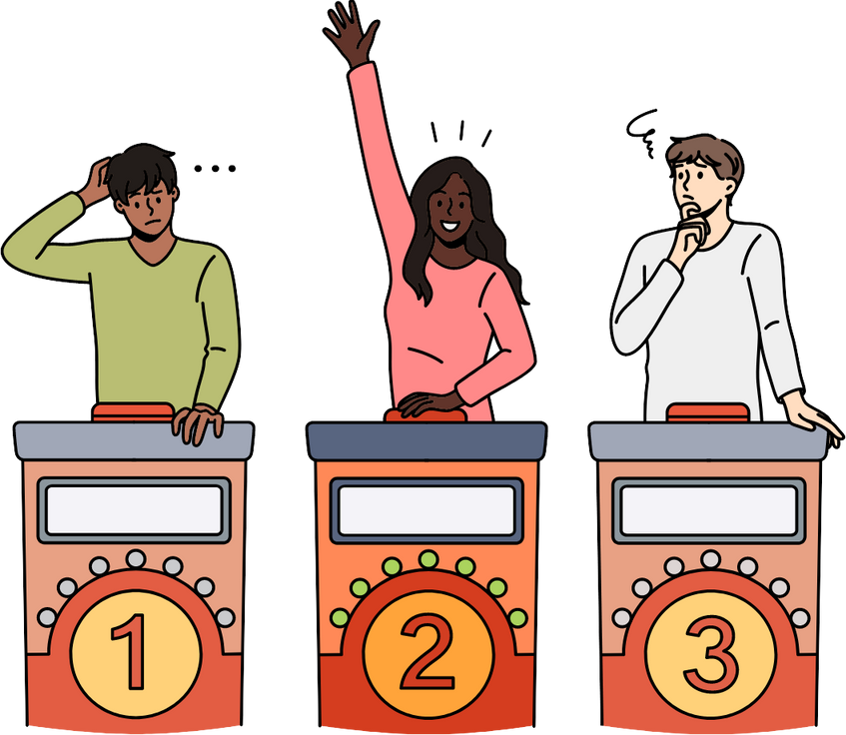
Mental Health Quiz
False
True
False

Slide 2


Mental health accounted for more lost working time than confirmed COVID cases.

Slide 3
Mental health issues were the primary reason for time off work during 2021. GoodShape's UK PLC 2021 Workforce Health Report reveals that in 2021, poor mental health accounted for 19 per cent of all lost working time across the country, followed by confirmed cases of COVID which represented 16 per cent.
(GoodShape)
Notes:
https://blog.goodshape.com/insights/poor-mental-health-is-number-one-reason-for-time-off-work-for-uk-employees-in-2021#:~:text=Mental%20health%20issues%20were%20the,which%20represented%2016%20per%20cent.

Slide 4

On average, how much do mental health problems cost the UK economy?
£82 Billion
£90 Billion
£118 Billion

Slide 5
Mental health problems cost the UK economy at least £117.9 billion per year. The cost of mental health problems is equivalent to around 5% of the UK’s GDP. Almost three quarters of the cost (72%) is due to the lost productivity of people living with mental health conditions and costs incurred by unpaid informal carers.
£118 Billion
(Mental Health Foundation & LSE)
Notes:
https://www.mentalhealth.org.uk/sites/default/files/2022-06/MHF-Investing-in-Prevention-Full-Report.pdf

Slide 6

In 2022/23, how many cases of work-related stress, depression or anxiety were there in Great Britain?
870,000
875,000
900,000

Slide 7
The figures from Great Britain’s workplace regulator show there were an estimated 875,000 cases of work-related stress, depression, or anxiety in 2022/23. In the recent years prior to the coronavirus pandemic, the rate of self-reported work-related stress, depression or anxiety had shown signs of increasing. The current rate is higher than the 2018/19 pre-coronavirus level.
875,000
The Health and Safety Executive (HSE)
Notes:
https://www.hse.gov.uk/statistics/assets/docs/hssh2223.pdf

Slide 8
On average, for every £1 businesses spend on wellbeing, what return can they expect?
£3
£4
£5

Slide 9
Employers can invest in providing support to improve the mental wellbeing of employees through measures such as training, promoting general awareness of mental health issues and targeted interventions.
£5
(Deloitte)
Notes:
https://www2.deloitte.com/content/dam/Deloitte/uk/Documents/consultancy/deloitte-uk-mental-health-report-2022.pdf

Slide 10
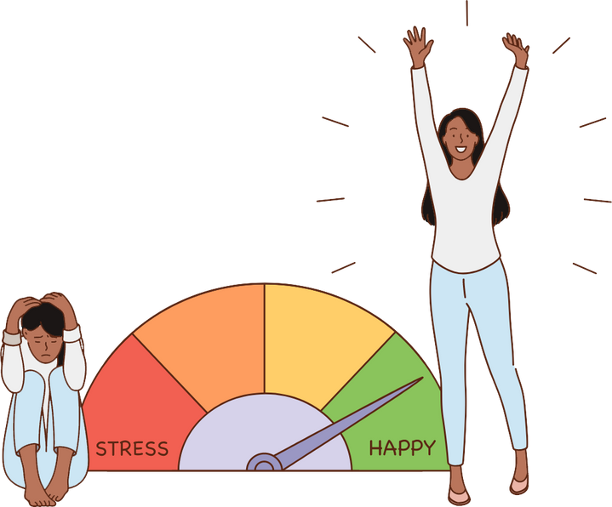
Which of these symptoms can happen if you’re depressed?
Don’t feel hungry
Hungry all the time
Always tired

Slide 11
People can experience depression in different ways. What most people experience, however, is sadness or hopelessness and very often they are no longer able to enjoy the things they previously took great pleasure in. But with the right help they can and do recover.
All of them
(Mind)
Notes:
https://www.mind.org.uk/information-support/types-of-mental-health-problems/depression/symptoms/

Slide 12
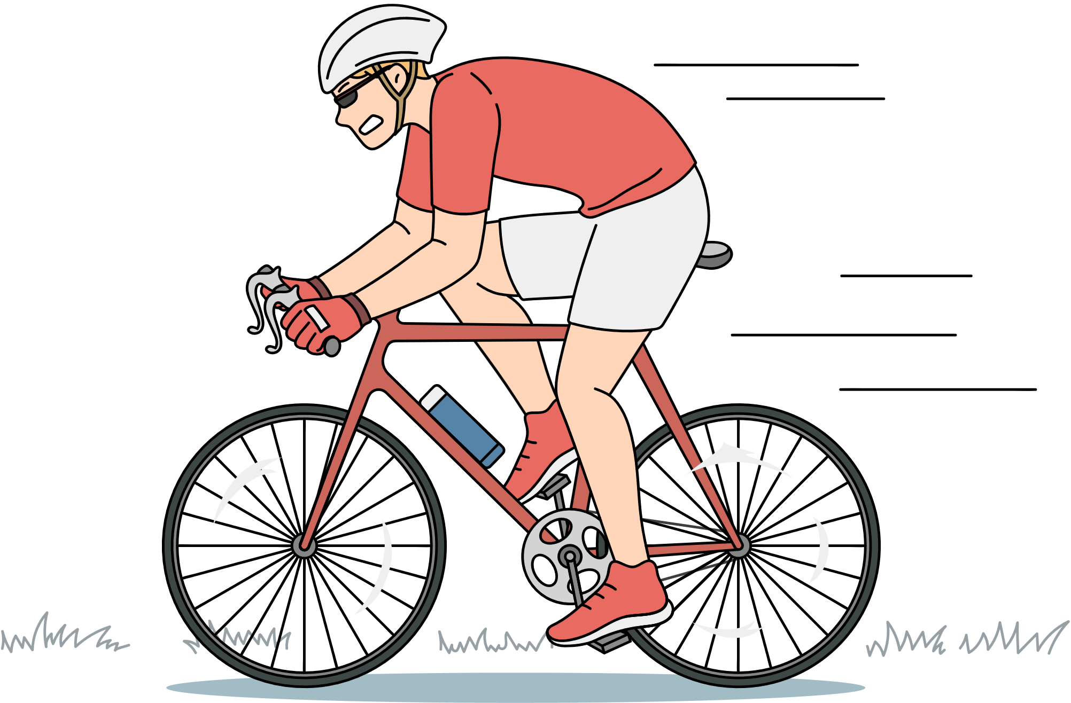
What can exercise do for your mental health?
Nothing, it’s only good for your physical health
It stops you from facing your problems
It releases endorphins that make you feel good

Slide 13
Exercise not only benefits your physical and mental health, but it also improves your overall mood and happiness. When you exercise, endorphins (a feel-good chemical) are released in the brain, leading to an overall more positive mood. Exercise can also lead to a boost in self-esteem and self-confidence.
It releases endorphins
(Mind)
Notes:
https://www.mind.org.uk/information-support/tips-for-everyday-living/physical-activity-exercise-and-mental-health/how-are-physical-activity-and-mental-health-connected/

Slide 14


Let's Talk
support@matesinmind.org
020 3510 5018
Be a mate.
Be the change.

