Slide 1
Mental Health Quiz

Slide 2
True or False, mental health accounted for more lost working time than confirmed COVID cases.
True
False
UK PLC 2021 Workforce Health Report
Notes:
The correct answer is 57%, more than half!

Slide 3
True or False, mental health accounted for more lost working time than confirmed COVID cases.
True
False
Mental health issues were the primary reason for time off work during 2021. GoodShape's UK PLC 2021 Workforce Health Report reveals that in 2021, poor mental health accounted for 19 per cent of all lost working time across the country, followed by confirmed cases of COVID which represented 16 per cent.
UK PLC 2021 Workforce Health Report
Notes:
The correct answer is 57%, more than half!

Slide 4
In 2021, how much did mental health problems cost to the UK economy
£20 Billion
£25 Billion
£118 Billion
(Centre for mental health, 2021)
Notes:
The correct answer is £8.4 billion

Slide 5
In 2021, how much did mental health problems cost to the UK economy
£20 Billion
£25 Billion
£118 Billion
Mental health at work: The business costs ten years on finds that by far the largest part of the business cost is in the form of reduced productivity among people who are at work but unwell: or ‘presenteeism’. This costs businesses twice as much as sickness absence relating to poor mental health. The remainder of the cost relates to turnover – people leaving their jobs as a result of poor mental health.
(Centre for mental health, 2021)
Notes:
The correct answer is £8.4 billion

Slide 6
In 2021, how many UK workers suffered from work-related stress, depression or anxiety?
811,000
822,000
833,000
Statistia.com
Notes:
The correct answer is 595,000

Slide 7
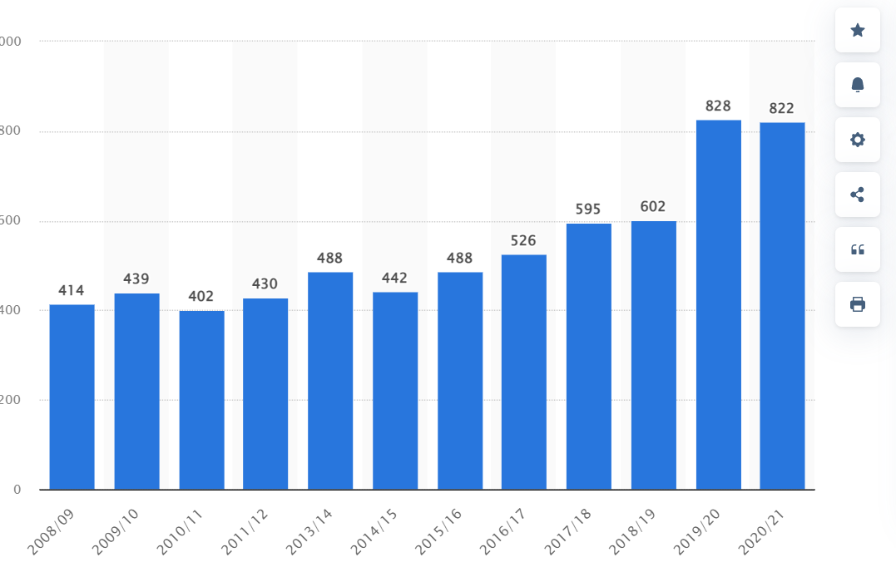
In 2021, how many UK workers suffered from work-related stress, depression or anxiety?
811,000
822,000
833,000
Statistia.com
Notes:
The correct answer is 595,000

Slide 8
In the UK, what percentage of all work related illnesses were attributed to mental ill health in 2020/2021?
44%
50%
54%
(HSE health and safety at work report, 2020/2021)
Notes:
The correct answer is 44%, nearly half!

Slide 9
In the UK, what percentage of all work related illnesses were attributed to mental ill health in 2020/2021?
44%
50%
54%
(HSE health and safety at work report, 2020/2021)
Notes:
The correct answer is 44%, nearly half!

Slide 10
In 2021, how many UK workers felt that their mental health was supported at work?
11%
14%
16%
The Guardian
Notes:
The correct answer is 49%, half the UK workforce!

Slide 11
In 2021, how many UK workers felt that their mental health was supported at work?
11%
14%
16%
The Guardian
Notes:
The correct answer is 49%, half the UK workforce!

Slide 12
How many times higher is the suicide rate among male labourers compared to the national average?
2.5 times higher
3.7 times higher
1.2 times higher
(Office of National Statistics,)
Notes:
3.7 x higher

Slide 13
How many times higher is the suicide rate among male labourers compared to the national average?
2.5 times higher
3.7 times higher
1.2 times higher
(Office of National Statistics,)
Notes:
3.7 x higher

Slide 14
Be a Mate.
Be the Change.
E. support@matesinmind.org
T. 020 3510 5018
matesinmind.org

